Slide 1
2. Bitcoin Keys, Addresses, and Wallets
Mastering Bitcoin - Programming the Open Blockchain, 2nd Ed., 2017

Slide 2
Introduction (1/2)
Ownership of bitcoin is established through digital keys, bitcoin addresses, and digital signatures. The digital keys are not actually stored in the network, but are instead created and stored by users in a file, or simple database, called a wallet.
Keys come in pairs consisting of a private (secret) key and a public key. Think of the public key as similar to a bank account number and the private key as similar to the secret PIN, or signature on a check, that provides control over the account.
Most bitcoin transactions requires a valid digital signature to be included in the blockchain, which can only be generated with a secret key; therefore, anyone with a copy of that key has control of the bitcoin.

Slide 3
Introduction (2/2)
In the payment portion of a bitcoin transaction, the recipient’s public key is represented by its digital fingerprint, called a bitcoin address, which is used in the same way as the beneficiary name on a check (i.e., “Pay to the order of”).
In most cases, a bitcoin address is generated from and corresponds to a public key. However, not all bitcoin addresses represent public keys; they can also represent other beneficiaries such as scripts. This way, bitcoin addresses abstract the recipient of funds, making transaction destinations flexible.
The bitcoin address is the only representation of the keys that users will routinely see, because this is the part they need to share with the world.

Slide 4
Public Key Cryptography (1/3)
Public key cryptography (also called “asymmetric cryptography”) uses unique keys to secure information. These keys are based on mathematical functions that have a special property: it is easy to calculate them, but hard to calculate their inverse.
  Multiplying two large prime numbers together is trivial. But given the product of two large primes, it is very difficult to find the prime factors (a problem called prime factorization). Let’s say we present the number 8,018,009 and tell you it is the product of two primes. Finding those two primes is much harder for you than it was for me to multiply them to produce 8,018,009.
  Such functions are often called trapdoor functions because they are very difficult to invert unless you are given a piece of secret information. E.g. given one of the prime factors 2,003, you can trivially find the other one with a simple division: 8,018,009 ÷ 2,003 = 4,003.

Slide 5
Public Key Cryptography (2/3)
Bitcoin uses a more advanced category of mathematical functions, namely elliptic curve multiplication, as the basis for its cryptography.
  Public key cryptography is used to create a key pair that controls access to bitcoin. The key pair consists of a private key and—derived from it—a unique public key. The public key is used to receive funds, and the private key is used to sign transactions to spend the funds.
  There is a mathematical relationship between the public and the private key that allows the private key to be used to generate signatures on messages. This signature can be validated against the public key without revealing the private key.
  When spending bitcoin, the current bitcoin owner presents his/her public key and a signature in a transaction to spend those bitcoin. Through the presentation of the public key and signature, everyone in the bitcoin network can verify and accept the transaction as valid, confirming that the person transferring the bitcoin owned them at the time of the transfer.

Slide 6
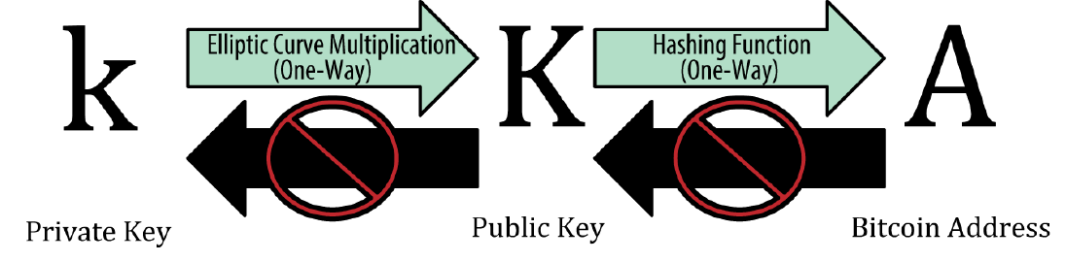
Public Key Cryptography (3/3)
Why is asymmetric cryptography used in bitcoin?
  It’s not used to “encrypt” the transactions. Rather, the useful property of asymmetric cryptography is the ability to generate digital signatures.
  The signature can only be produced by someone with knowledge of the private key. However, anyone with access to the public key and the transaction fingerprint can use them to verify the signature.

Slide 7
Private Keys (1/2)
A private key is simply a number, picked at random. Ownership and control over the private key is the root of user control over all funds associated with the corresponding bitcoin address.
The private key is used to create signatures that are required to spend bitcoin by proving ownership of funds used in a transaction.
The private key must remain secret at all times, because revealing it to third parties is equivalent to giving them control over the bitcoin secured by that key.
The private key must also be backed up and protected from accidental loss, because if it’s lost it cannot be recovered and the funds secured by it are forever lost, too.

Slide 8
Private Keys (2/2)
Creating a bitcoin key is essentially the same as “Pick a number between 1 and 2²⁵⁶.” More precisely, the private key can be any number between 1 and n - 1, where n is a prime (n ≈ 1.158*10⁷⁷, a, slightly less than 2²⁵⁶) defined as the order of the elliptic curve used in bitcoin.
  n = 115792089237316195423570985008687907852837564279074904382605163141518161494337
  To create such a key, we randomly pick a 256-bit number and check that it is less than n - 1. In programming terms, this is usually achieved by feeding a larger string of random bits into the SHA256 hash algorithm, which will conveniently produce a 256-bit number. If the result is less than n - 1, we have a suitable private key. Otherwise, we try again with another random number.
  For comparison, the visible universe is estimated to contain 10⁸⁰ atoms.

Slide 9
Public Keys
The public key is calculated from the private key using elliptic curve multiplication, which is irreversible: K = k * G, where k is the private key, G is a constant point called the generator point (2D), and K is the resulting public key.
The reverse operation, known as “finding the discrete logarithm”—calculating k if you know K—is as difficult as trying all possible values of k, i.e., a brute-force search.

Slide 10
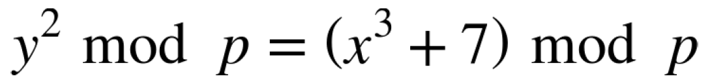

Elliptic Curve Cryptography Explained (1/5)
Bitcoin uses a specific elliptic curve and set of mathematical constants, as defined in a standard called secp256k1, established by the National Institute of Standards and Technology (NIST).
The secp256k1 curve is defined by the following function, which produces an elliptic curve:
The mod p (modulo prime number p) indicates that this curve is over a finite field of prime order p, also written as , where p = 2²⁵⁶ – 2³² – 2⁹ – 2⁸ – 2⁷ – 2⁶ – 2⁴ – 1, a very large prime number.

Slide 11
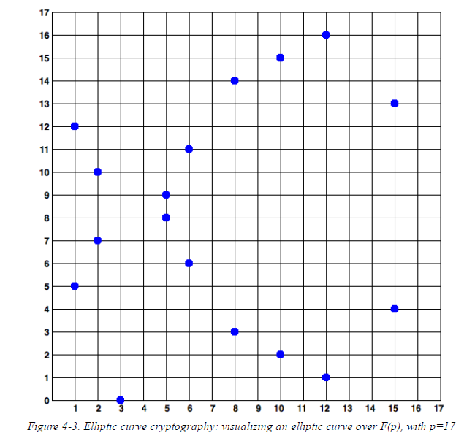
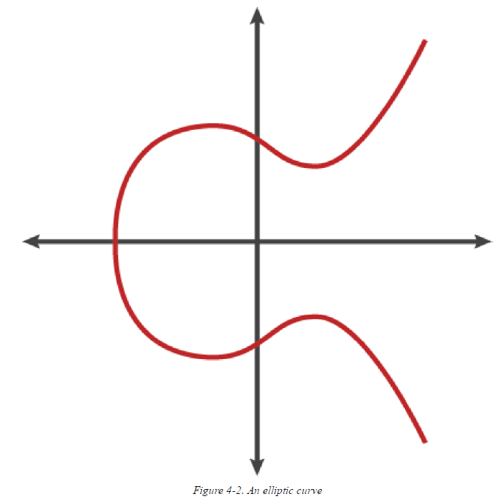
Elliptic Curve Cryptography Explained (2/5)
Because this curve is defined over a finite field of prime order instead of over the real numbers, it looks like a pattern of dots scattered in two dimensions.

Slide 12
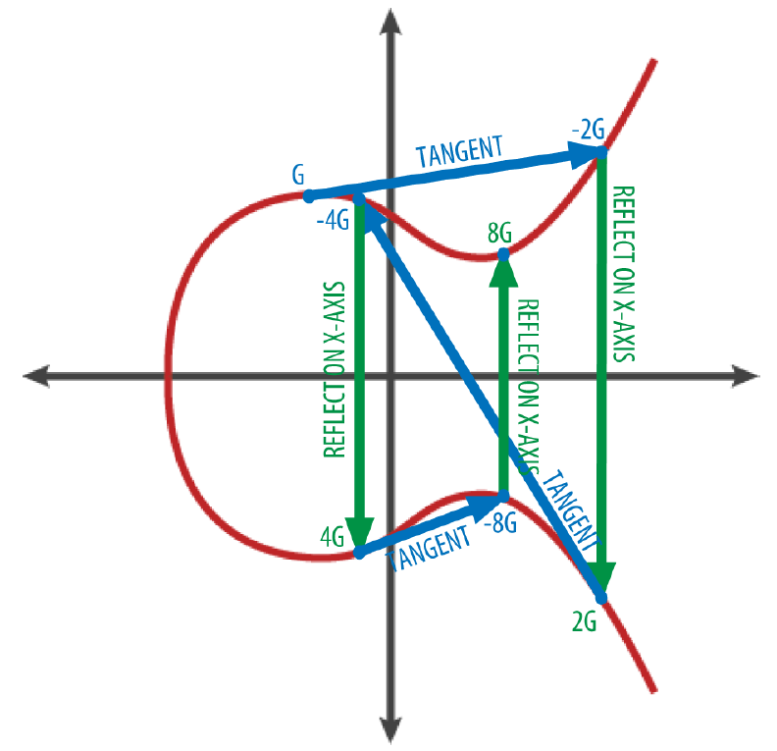
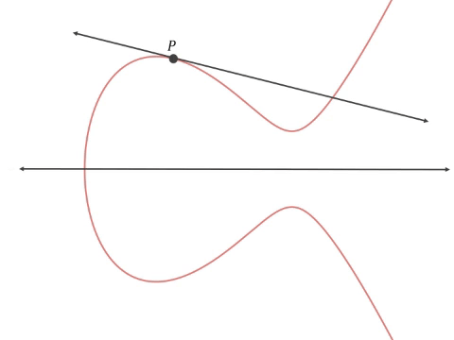
Elliptic Curve Cryptography Explained (3/5)
Given two points P₁ and P₂ on the elliptic curve, there is a third point P₃ = P₁ + P₂ , also on the elliptic curve.
For a point P on the elliptic curve, if k is a whole number, then kP = P + P + P + … + P (k times).

Slide 13

Elliptic Curve Cryptography Explained (4/5)
Generating a Public Key
  Starting with a private key in the form of a randomly generated number k, we multiply it by a predetermined point on the curve called the generator point G to produce another point somewhere else on the curve, which is the corresponding public key K.
  where k is the private key, G is the generator point, and K is the resulting public key, a point on the curve. Because the generator point is always the same for all bitcoin users, a private key k multiplied with G will always result in the same public key K. The relationship between k and K is fixed, but can only be calculated in one direction, from k to K.
  That’s why a bitcoin address (derived from K) can be shared with anyone and does not reveal the user’s private key (k).
(2D)
(1D)
(2D)

Slide 14
Elliptic Curve Cryptography Explained (5/5)
The base point G in compressed form
  G = 02 79BE667E F9DCBBAC 55A06295 CE870B07 029BFCDB 2DCE28D9 59F2815B 16F81798
  (x-coordinate)
The base point G in uncompressed form
  G = 04 79BE667E F9DCBBAC 55A06295 CE870B07 029BFCDB 2DCE28D9 59F2815B 16F81798
  483ADA77 26A3C465 5DA4FBFC 0E1108A8 FD17B448 A6855419 9C47D08F FB10D4B8
  (x-coordinate & y-coordinate)
For example
  K = 1E99423A4ED27608A15A2616A2B0E9E52CED330AC530EDCC32C8FFC6A526AEDD * G
  Public key K is defined as a point K = (x, y)
  x = F028892BAD7ED57D2FB57BF33081D5CFCF6F9ED3D3D7F159C2E2FFF579DC341A
  y = 07CF33DA18BD734C600B96A72BBC4749D5141C90EC8AC328AE52DDFE2E505BDB

Slide 15
Bitcoin Addresses (1/4)
A bitcoin address is a string of digits and characters that can be shared with anyone who wants to send you money. Addresses produced from public keys consist of a string of numbers and letters, beginning with the digit “1.”
A bitcoin address can represent the owner of a private/public key pair, or it can represent something else, such as a payment script, as we will see in “Pay-to-Script-Hash (P2SH)”.
The simple case, a bitcoin address that represents, and is derived from, a public key.
The bitcoin address is derived from the public key through the use of one-way cryptographic hashing. A “hashing algorithm” or simply “hash algorithm” is a one-way function that produces a fingerprint or “hash” of an arbitrary-sized input.

Slide 16
Bitcoin Addresses (2/4)
The algorithms used to make a bitcoin address from a public key are the Secure Hash Algorithm (SHA) and the RACE Integrity Primitives Evaluation Message Digest (RIPEMD), specifically SHA256 and RIPEMD160.
Starting with the public key K, we compute the SHA256 hash and then compute the RIPEMD160 hash of the result, producing a 160-bit (20-byte) number:
where K is the public key and A is the resulting bitcoin address.
(2D of 256-bit = 512-bit)
(160-bit)

Slide 17
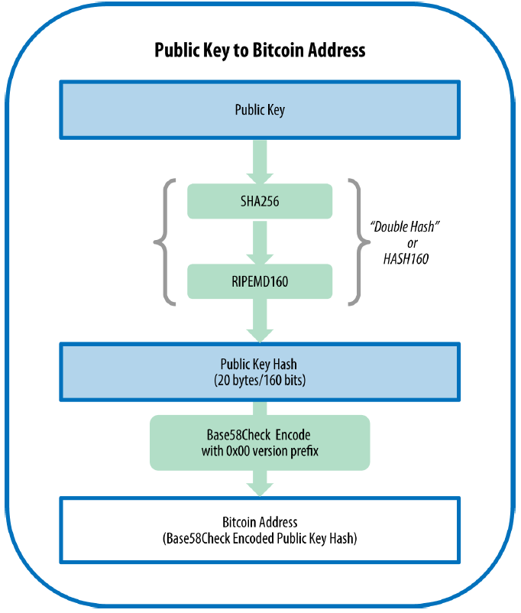
Bitcoin Addresses (3/4)
Bitcoin addresses are almost always encoded as “Base58Check”, which uses 58 characters (a Base58 number system) and a checksum to help human readability, avoid ambiguity, and protect against errors in address transcription and entry.
  Its alphabet avoids similar looking letters
  It does not use non-alphanumeric characters
  These features help humans to make less errors and allows direct inclusion in filenames and URLs.

Slide 18
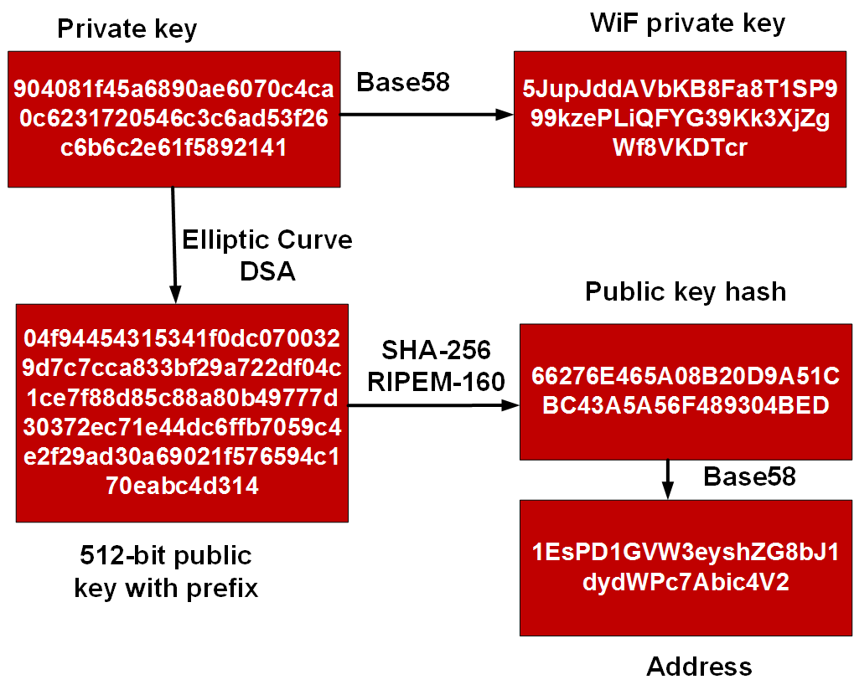
Bitcoin Addresses (4/4)
(Wallet Import Format)

Slide 19
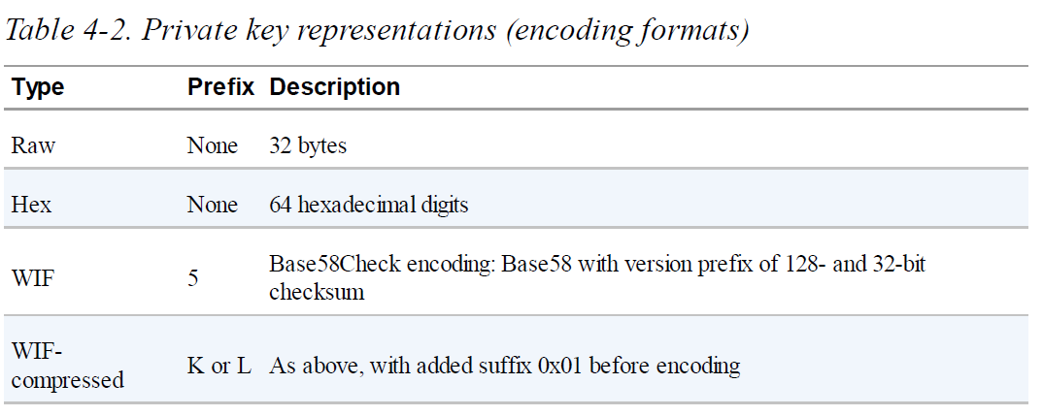
Key Formats (1/2)
Note: Wallet Import Format (WIF)

Slide 20
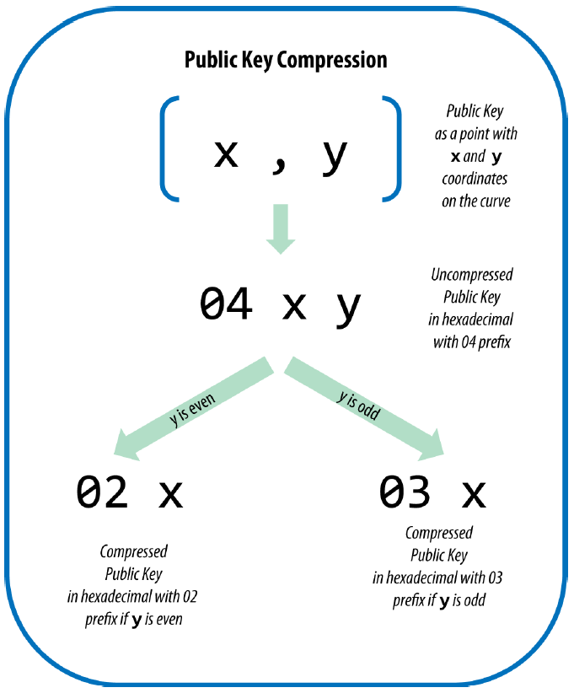
Key Formats (2/2)
Public keys are also presented in different ways, usually as either compressed or uncompressed public keys.
  Uncompressed: 520-bit number (130 hex digits) with the prefix 04 followed by x and then y coordinates, as 04 x y:
  Compressed: if we know the x coordinate we can calculate the y coordinate by solving the elliptic curve equation, but we need to specify the sign (+ or -) of the y coordinate by either a 02 or a 03 prefix.
positive
negative

Slide 21
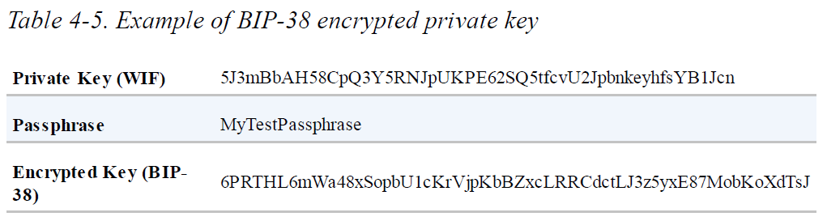
Advanced Keys and Addresses (1/4)
Encrypted Private Keys (BIP-38) (Bitcoin Improvement Proposal)
  BIP-38 proposes a common standard for encrypting private keys with a passphrase and encoding them with Base58Check so that they can be stored securely on backup media, transported securely between wallets, or kept in any other conditions where the key might be exposed.

Slide 22
Advanced Keys and Addresses (2/4)
Pay-to-Script Hash (P2SH) and Multisig Addresses
  Traditional bitcoin addresses begin with the number “1” (also known as pay-to-public-key-hash, P2PKH) are derived from the public key, which is derived from the private key.
  Bitcoin addresses that begin with the number “3” are pay-to-script hash (P2SH) addresses, sometimes erroneously called multisignature or multisig addresses. They designate the beneficiary of a bitcoin transaction as the hash of a script, instead of the owner of a public key.
  A P2SH address is created from a transaction script, which defines who can spend a transaction output. Encoding a P2SH address involves using the same double-hash function as used during creation of a bitcoin address, only applied on the script instead of the public key:

Slide 23
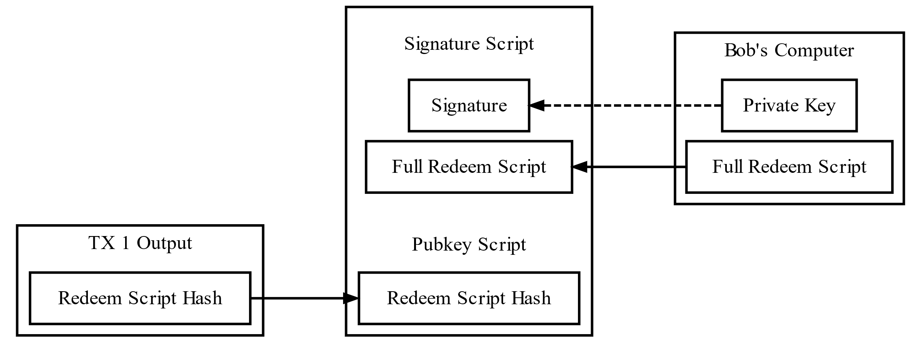
Advanced Keys and Addresses (3/4)
  Currently, the most common implementation of the P2SH function is the multisignature address script. As the name implies, the underlying script requires more than one signature to prove ownership and therefore spend funds.
  The bitcoin multisignature feature is designed to require M signatures (also known as the “threshold”) from a total of N keys, known as an M-of-N multisig, where M is equal to or less than N.
Spending a P2SH Output
(Details will be covered in the lecture of “Bitcoin Transaction”

Slide 24
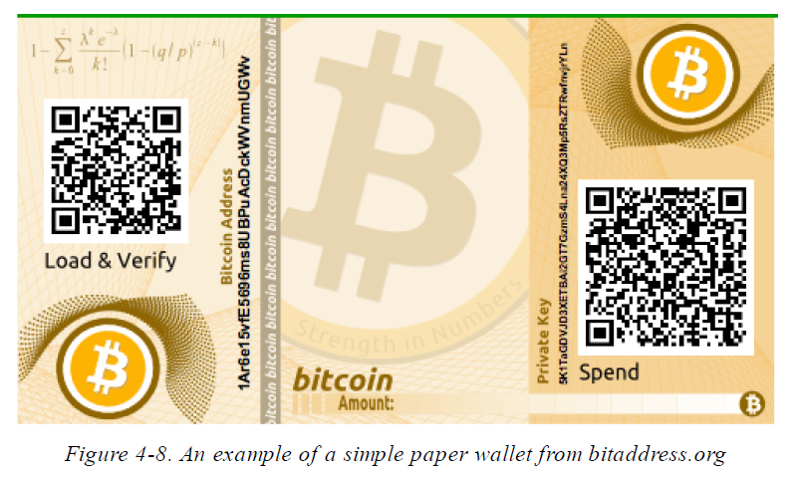
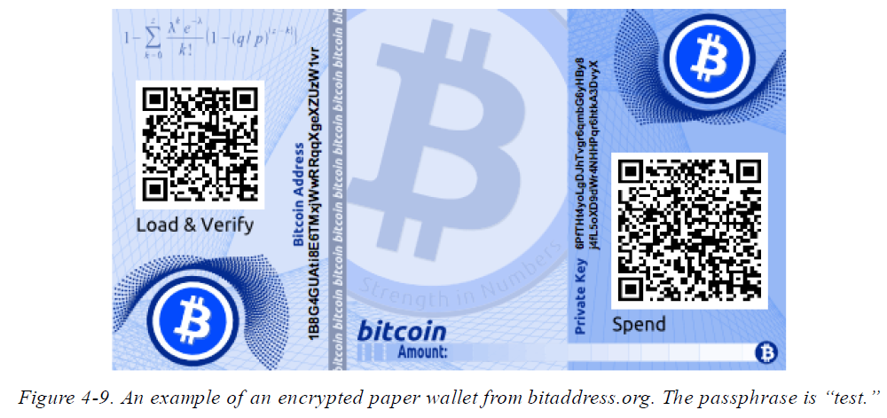
Advanced Keys and Addresses (4/4)
Paper Wallets
  Paper wallets are bitcoin private keys printed on paper, which are a very effective way to create backups or offline bitcoin storage, also known as “cold storage.” As a “cold storage” mechanism, if the paper wallet keys are generated offline and never stored on a computer system, they are much more secure against hackers, keyloggers, and other online computer threats.
BIP-38

Slide 25
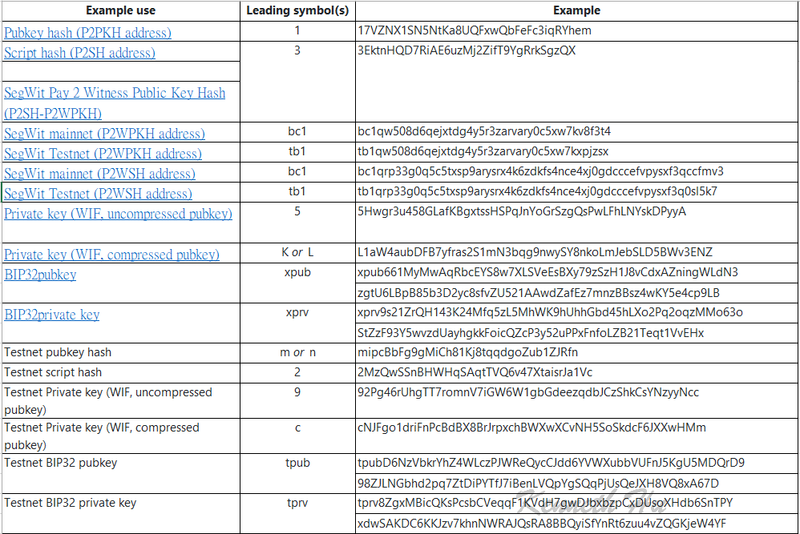
Ref. Full list of Bitcoin address prefixes (1/2)
https://allprivatekeys.com/bitcoin-address-format

Slide 26
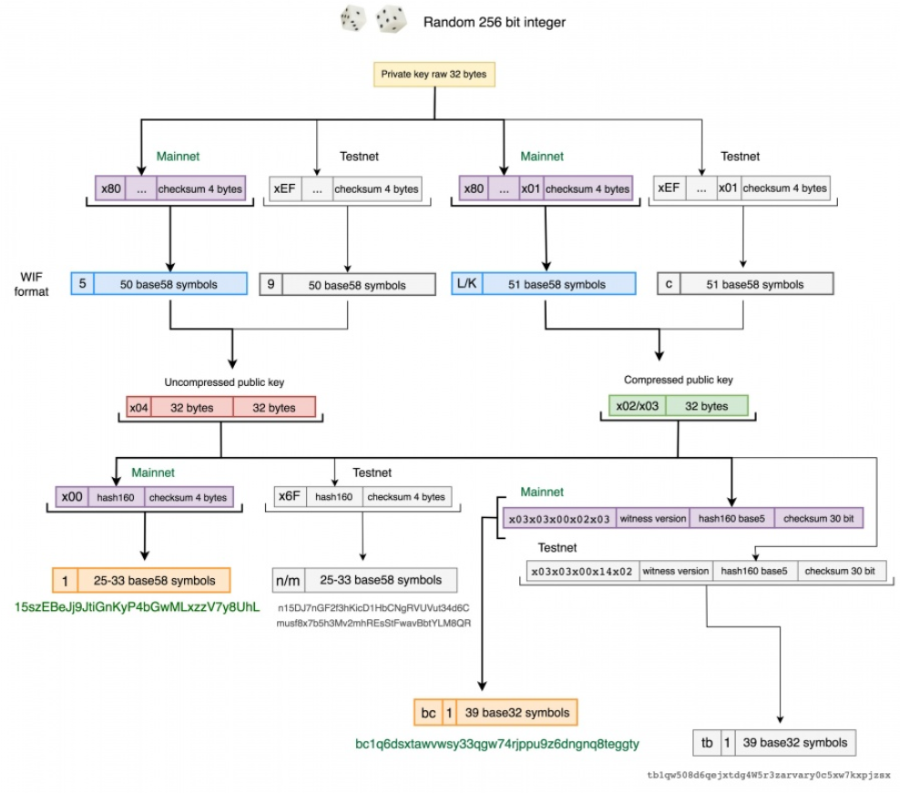
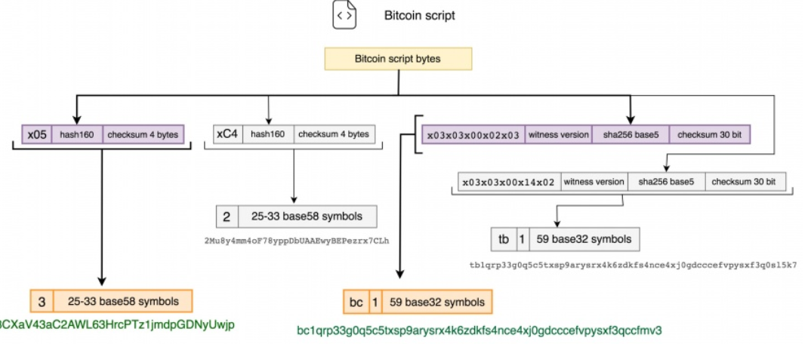
Ref. Full list of Bitcoin address prefixes (2/2)

Slide 27
Wallet Technology Overview
A common misconception about bitcoin is that bitcoin wallets contain bitcoin. In fact, the wallet contains only keys. The “coins” are recorded in the blockchain on the bitcoin network. Users control the coins on the network by signing transactions with the keys in their wallets. In a sense, a bitcoin wallet is a keychain.
There are two primary types of wallets, distinguished by whether the keys they contain are related to each other or not.
  Nondeterministic wallet: each key is independently generated from a random number. The keys are not related to each other.
  Deterministic wallet: all the keys are derived from a single master key, known as the seed. All the keys in this type of wallet are related to each other and can be generated again if one has the original seed.

Slide 28
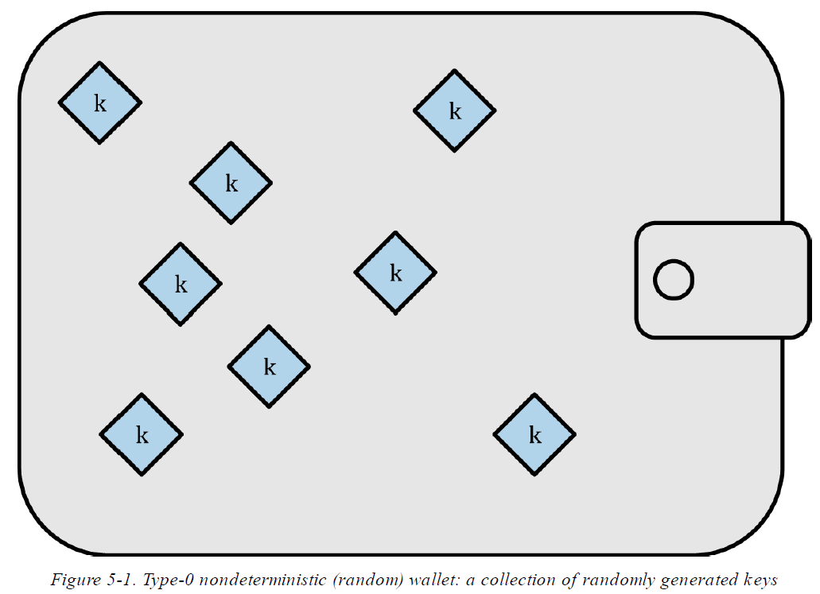
Nondeterministic (Random) Wallets
Such wallets are being replaced with deterministic wallets because they are cumbersome to manage, back up, and import.

Slide 29
Deterministic (Seeded) Wallets (1/2)
Deterministic, or “seeded,” wallets are wallets that contain private keys that are all derived from a common seed, through the use of a one-way hash function.
The seed is a randomly generated number that is combined with other data, such as an index number or “chain code” to derive the private keys.
In a deterministic wallet, the seed is sufficient to recover all the derived keys, and therefore a single backup at creation time is sufficient. The seed is also sufficient for a wallet export or import, allowing for easy migration of all the user’s keys between different wallet implementations.

Slide 30
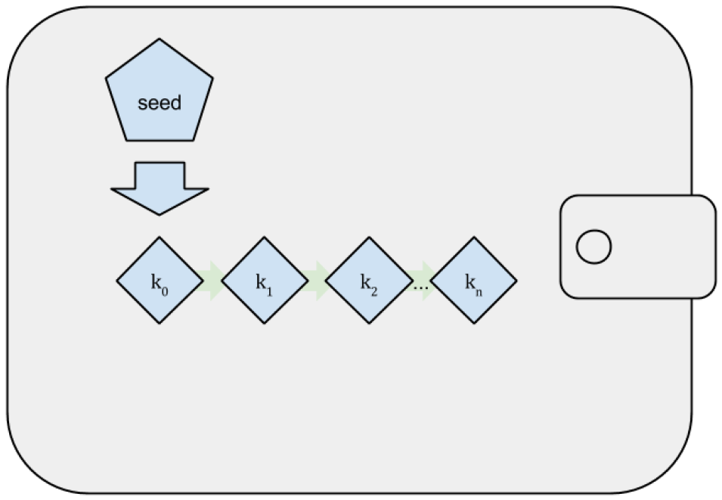
Deterministic (Seeded) Wallets (2/2)

Slide 31
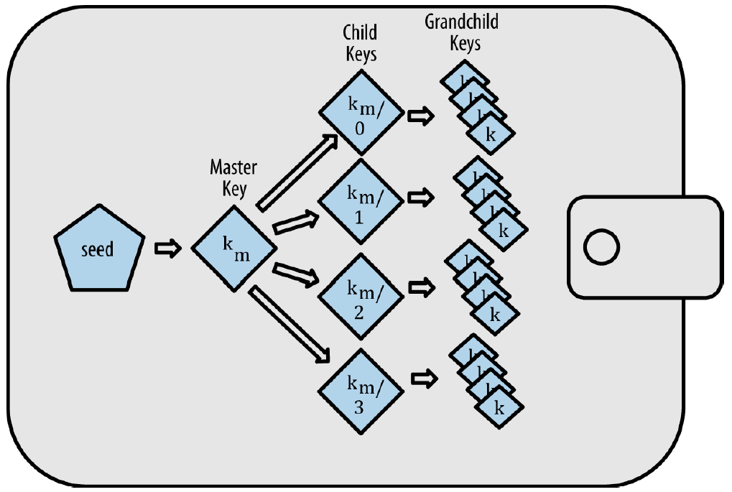
HD Wallets (BIP-32/BIP-44) (1/2)
Hierarchical Deterministic (HD) Wallets is the most advanced form of deterministic wallets defined by the BIP-32 standard.
HD wallets contain keys derived in a tree structure, such that a parent key can derive a sequence of children keys, each of which can derive a sequence of grandchildren keys, and so on, to an infinite depth.

Slide 32
HD Wallets (BIP-32/BIP-44) (2/2)
HD wallets advantages
  The tree structure can be used to express additional organizational meaning, such as when a specific branch of subkeys is used to receive incoming payments and a different branch is used to receive change from outgoing payments. (Or allocating different branches to departments…)
  Users can create a sequence of public keys without having access to the corresponding private keys. This allows HD wallets to be used on an insecure server or in a receive-only capacity, issuing a different public key for each transaction. The public keys do not need to be preloaded or derived in advance, yet the server doesn’t have the private keys that can spend the funds.

Slide 33
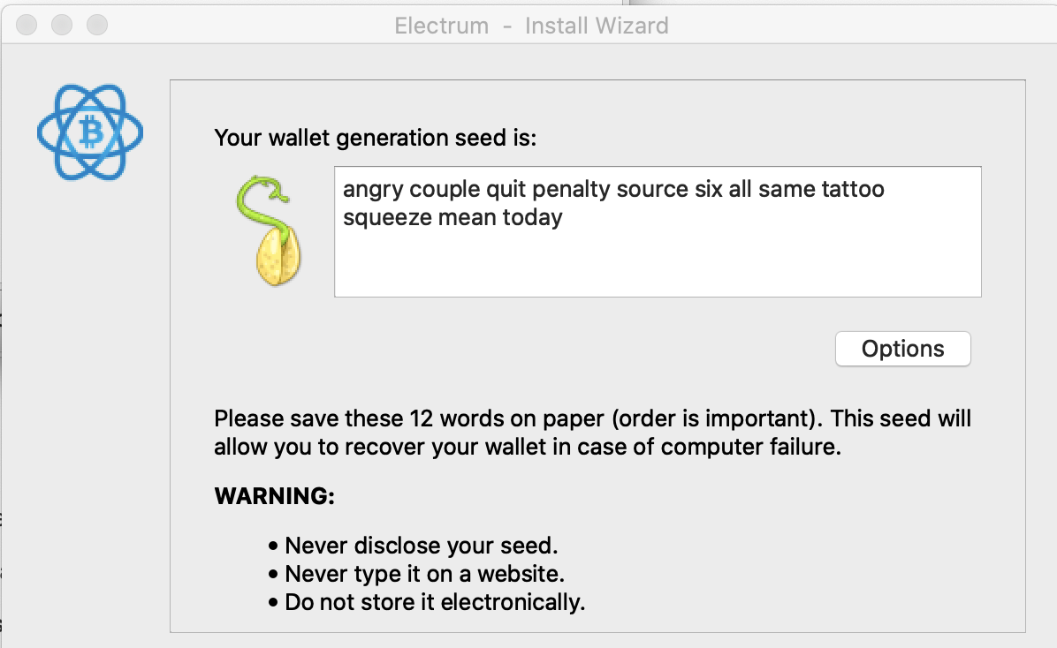
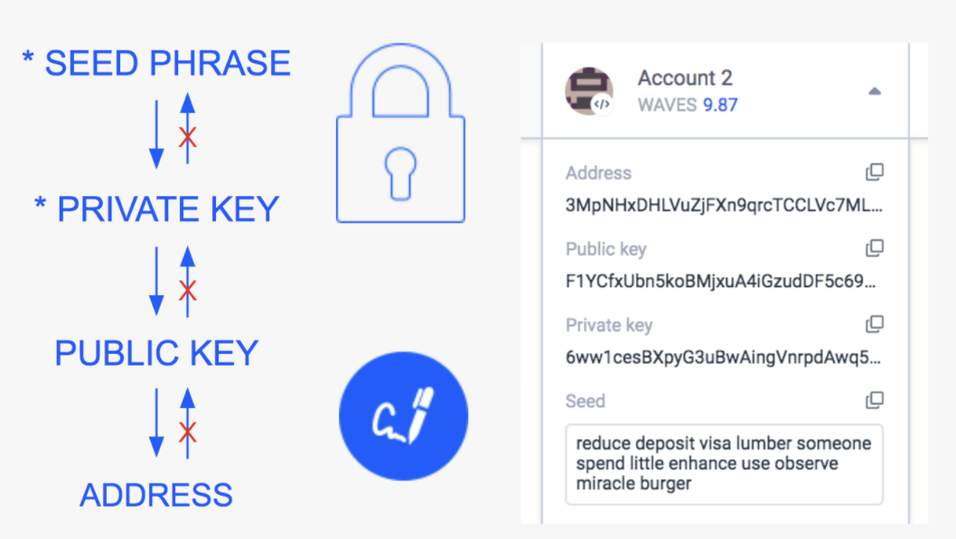
Seeds and Mnemonic Codes (BIP-39)
HD wallets are a very powerful mechanism for managing many keys and addresses. They are even more useful if they are combined with a standardized way of creating seeds from a sequence of English words that are easy to transcribe, export, and import across wallets.
This is known as a mnemonic
and the standard is defined
by BIP-39.

Slide 34
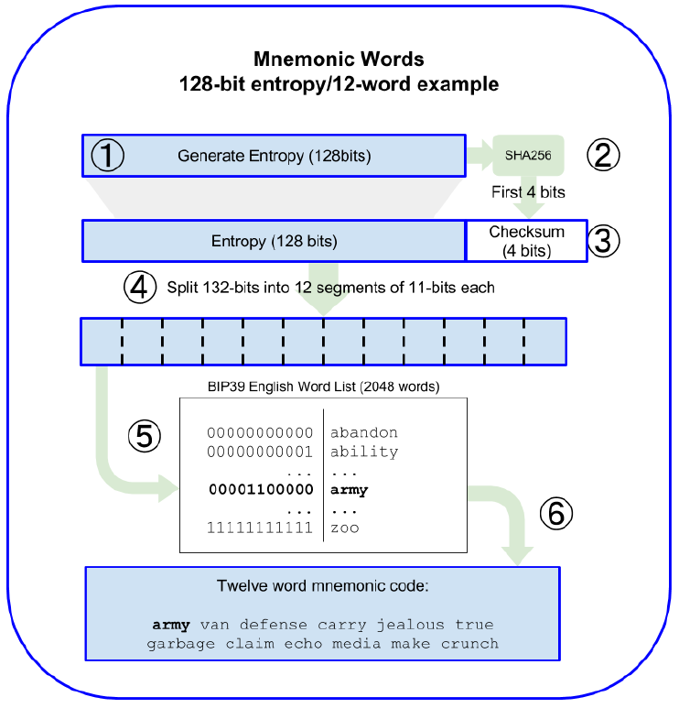
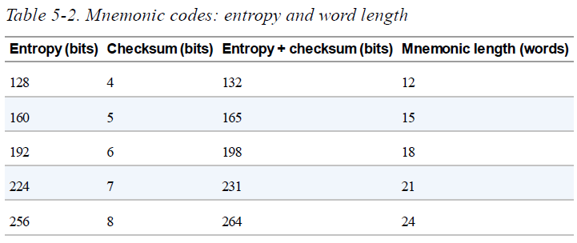
Mnemonic Code Words (BIP-39) (1/2)

Slide 35
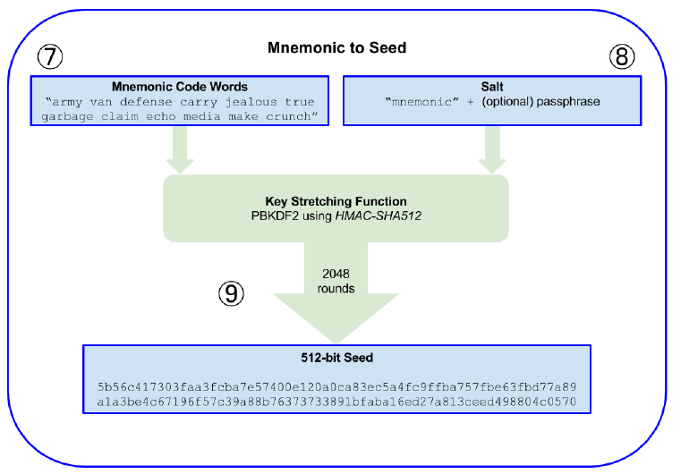
Mnemonic Code Words (BIP-39) (2/2)
The key-stretching function, with its 2048 rounds of hashing, is a very effective protection against brute-force attacks against the mnemonic or the passphrase. It makes it extremely costly to try more than a few thousand passphrase and mnemonic combinations, while the number of possible derived seeds is vast (2⁵¹²).

Slide 36
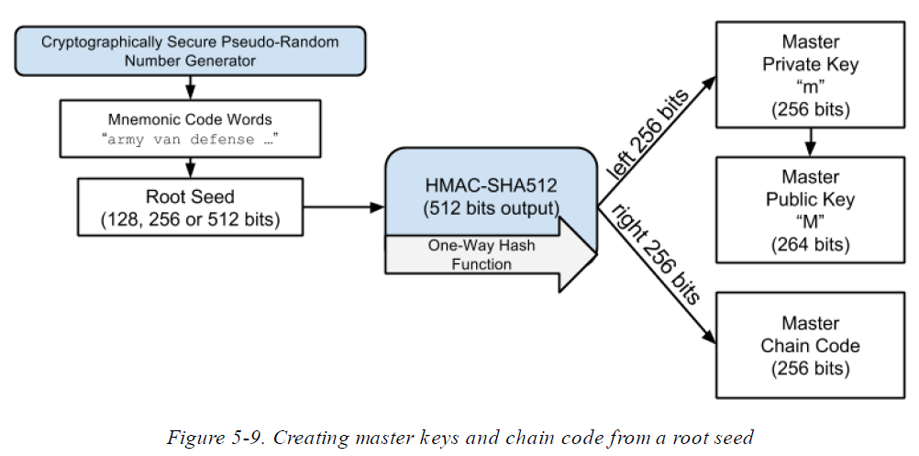
Creating an HD Wallet from the Seed (1/2)

Slide 37
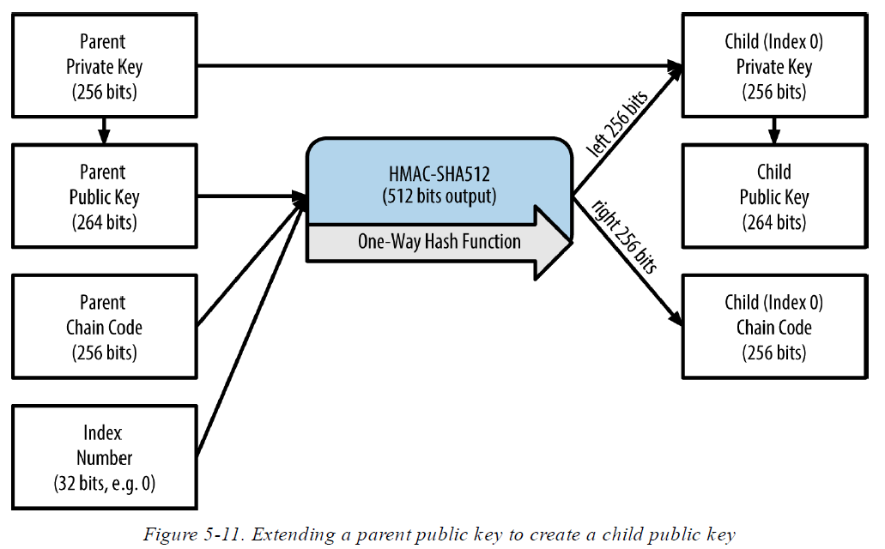
Creating an HD Wallet from the Seed (2/2)

Slide 38
Navigating the HD wallet tree structure
The HD wallet tree structure offers tremendous flexibility. Each parent extended key can have 4 billion children: 2 billion normal children and 2 billion hardened children. Each of those children can have another 4 billion children, and so on. The tree can be as deep as you want, with an infinite number of generations.
With all that flexibility, however, it becomes quite difficult to navigate this infinite tree. It is especially difficult to transfer HD wallets between implementations, because the possibilities for internal organization into branches and subbranches are endless.
Two BIPs offer solutions to this complexity by creating some proposed standards for the structure of HD wallet trees: BIP-43, BIP-44

Slide 39

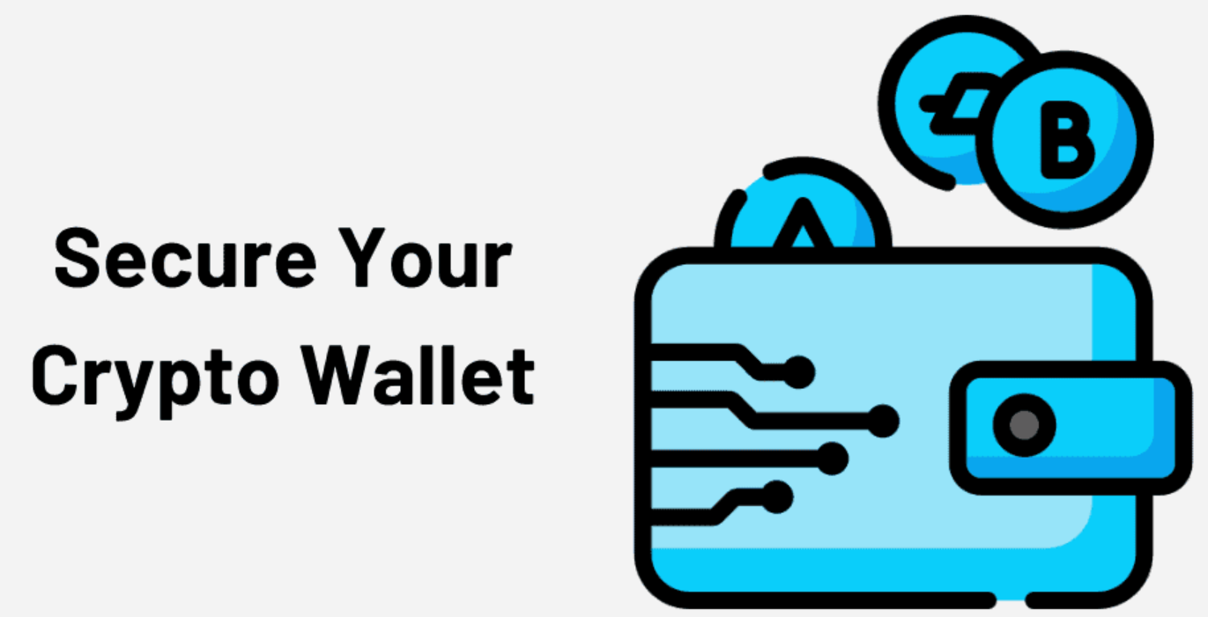
Wallet Best Practices
As bitcoin wallet technology has matured, certain common industry standards have emerged that make bitcoin wallets broadly interoperable, easy to use, secure, and flexible. These common standards are:
  Mnemonic code words, based on BIP-39
  HD wallets, based on BIP-32
  Multipurpose HD wallet structure, based on BIP-43
  Multicurrency and multiaccount wallets, based on BIP-44

Slide 40
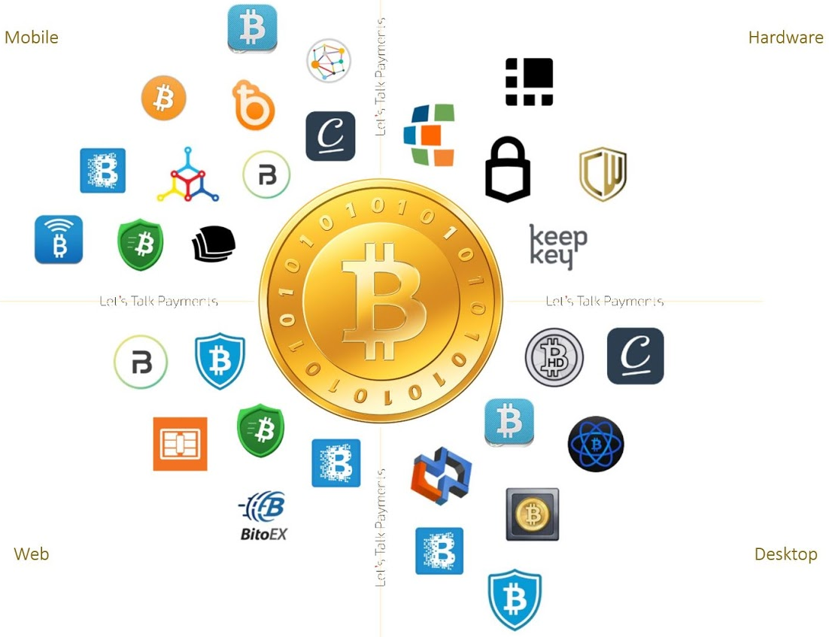

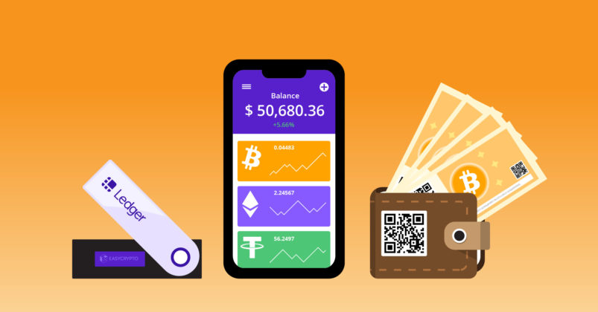
Four Types of Bitcoin/Crypto Wallets
Web (Cloud)
Mobile
Paper
Hardware

